Slide 1
HARDWARE IMPLEMENTATION OF THE PARTICLE SWARM OPTIMIZATION ALGORITHM
AMADEUSZ sZCZYPKOWSKI UWE Bristol 2018
Notes:
Hi Mehmed, hi everyone my name is Amadeusz and I am going to be presenting about Hardware implementation of the particle swarm optimization algorithm

Slide 2
Introduction What is the Idea of Particle Swarm Optimization (PSO)
Reflection of the idea is based on the observation of nature
Role of single particle (agent)
Reflection of the PSO in computers environment
Notes:
Slide intro The first slide is dedicated to introduction to and short general briefing about Particle Swarm Optimisation
Reflection of the idea is based on the observation of nature
Especially of ants and bees was taken in to consideration during creation of PSO algorithm. In swarms of animals the welfare of single particles (also called agents) is not as important as the benefit of the whole system and the behaviour of the swarm is a result of the behaviour of particular members of the swarm
- Role of single particle (agent)
Particular agents individually gain their own experience and pass it to other agents for further processing, this is how their work is bounded together. Other important factor is, each particle acquires the experience gained earlier by the overall swarm. This approach is one of the best ways of solving various problems. It reminds me of threads communication in parallel aspects of computer programs - Reflection of the PSO in computers environment As a reflection a single agent can be considered as a generic processing unit, which has its own computation capabilities and in the context of the overall group or network cluster, it is ale to perform even very complex tasks on behalf of the swarm or the network cluster.

Slide 3
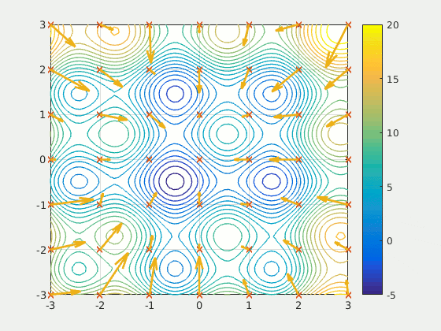
Movement of Particles in the PSO Algorithm
Iterations
Abstract Movement
Mathematical description
Fig.1 Particles Animation (Wikimedia Commons, 2018)
Notes:
Slide intro In this slide I will demonstrate and go over the movement of particles in the PSO algorithm. There are few movement key factors worth mentioning - Iterations
PSO might seem very complex, but it is a relatively a simple algorithm. Over certain number of iterations a set of variables associated with particular agents have their values adjusted to move the agents closer to on optimum solution (target). This helps new agents or agents situated far away from the target to find it over smaller amount of iterations. This is called swarm experience sharing.
- Movement
The movement of particles in the PSO algorithm resembles the movement that takes place in the swarm. However, the particles in the PSO algorithm are abstract entities with in the abstract environment. For this reason, some effects that occur in this case are not present in real swarms. For example, particular units may fall on each other and occupy the same points in the input data space.
- Mathematical description The mathematical description of the behaviour of the swarm is also only a simpliﬁed model of the behaviour of real swarms. Full Mathematical particle data description has been reserved for the next slide.
Animation sourced from (https://en.wikipedia.org/wiki/Particle_swarm_optimization#/media/File:ParticleSwarmArrowsAnimation.gif)

Slide 4
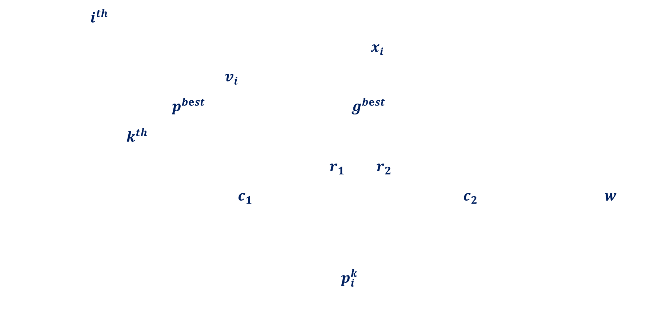
PSO algorithm Mathematical Data description
Particle $=i^{th}$
Coordinates of its own position in the input data space = $x_{i}$
Information on its own velocity = $v_{i}$
Personal best solution = $p^{bⅇst}$ Global best solution = $g^{bⅇst}$
Each iteration = $k^{th}$
Random values coming from uniform distribution = $r_{1}$ and $r_{2}$
Personal acceleration coefficient = $c_{1}$ Social acceleration coefficient = $c_{2}$ Inertia coefficient =${ w}_{}$
In addition to above parameters, each particle can obtain the value of the fitness function for a given position in the input data space
Signal for the position returned by fitness function = $p_{i}^{k}$
Notes:
Slide intro Before moving on to actual sequential and parallel hardware implementation of PSO algorithm I though it would be worth to go through and explain Mathematical data description along with Computational Sequence of algorithm which will be explained in the next slide
- Particle $=i^{th}$
In the PSO algorithm, $i^{th }$ stands for particle - Coordinates Coordinates of particles own position in the input data space are expressed by $x_{i}$
- Velocity Information of particles own velocity is described as $v_{i}$ - Personal best solution A personal (own) best solution is expressed as = $p^{bⅇst}$ (as well as the information in which place this solution has been found)
- Global best solution Global best solution is expressed as = $g^{bⅇst}$ with the information in which place this solution has been found
Each iteration = $k^{th}$
Random values coming from uniform distribution = $r_{1}$ and $r_{2}$
Personal acceleration coefficient = $c_{1}$ Social acceleration coefficient = $c_{2}$ Inertia coefficient =${ w}_{}$
-Fitness function The fitness function is in other words target function
The parameters are modified in the course of the learning process, in accordance with relatively simple mathematical rules

Slide 5
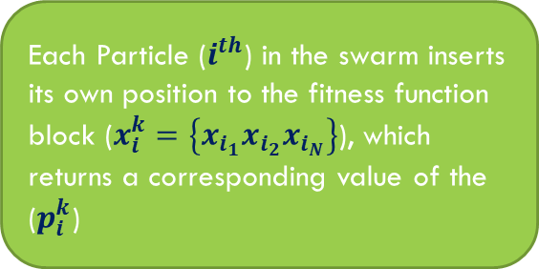
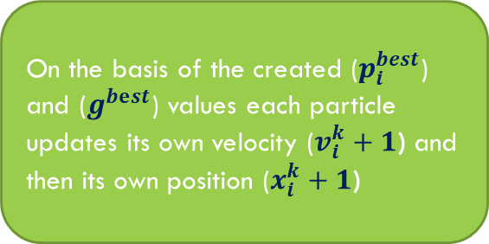
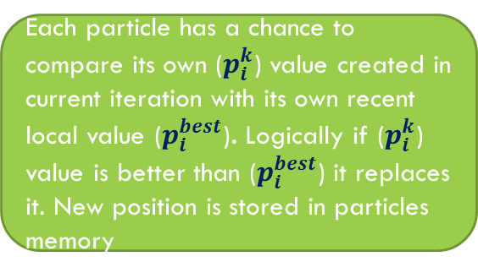
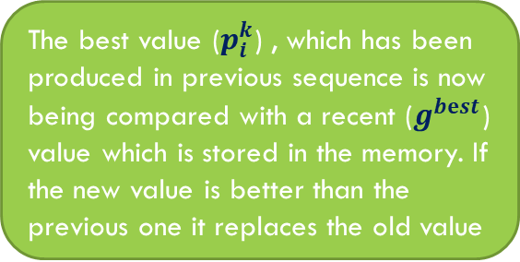
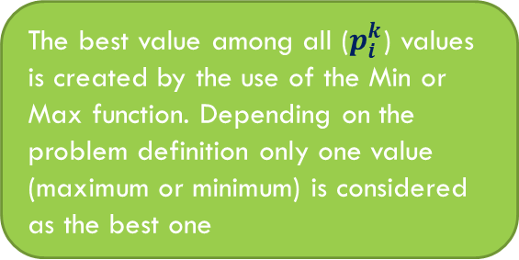
Computational sequence in the PSO algorithm
Start loop
Each Particle ($i^{th}$) in the swarm inserts its own position to the fitness function block ($x_{i}^{k}=\left\{x_{i_{1}}x_{i_{2}}x_{i_{N}}\right\}$), which returns a corresponding value of the ($p_{i}^{k}$)
The best value among all ($p_{i}^{k}$) values is created by the use of the Min or Max function. Depending on the problem definition only one value (maximum or minimum) is considered as the best one
The best value ($p_{i}^{k}$) , which has been produced in previous sequence is now being compared with a recent ($g^{bⅇst}$) value which is stored in the memory. If the new value is better than the previous one it replaces the old value
If a given principle is met exit the loop
On the basis of the created ($p_{i}^{best}$) and ($g^{bⅇst}$) values each particle updates its own velocity ($v_{i}^{k}+1$) and then its own position ($x_{i}^{k}+1$)
Each particle has a chance to compare its own ($p_{i}^{k}$) value created in current iteration with its own recent local value ($p_{i}^{best}$). Logically if ($p_{i}^{k}$) value is better than ($p_{i}^{best}$) it replaces it. New position is stored in particles memory
End loop
Fig.2 Sequence of PSO algorithm
Notes:
Slide intro This slide shows computational sequence in the PSO algorithm

Slide 6
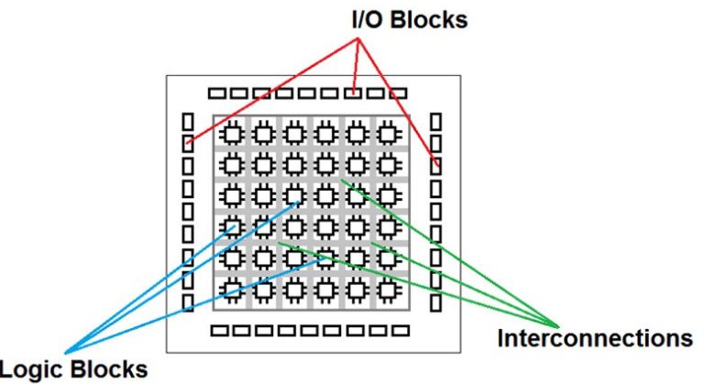
Hardware model of the PSO algorithm and Parallel Data processing
Parallel Processing and PSO Algorithm
Use of FPGA platforms
Use of ASIC alternative
Fig.3 FPGA Diagram (Semmer-Imagining, 2018)
Notes:
Slide intro jump in to first point - Parallel Processing and PSO Algorithm
As we already know in systems based on PSO algorithm all particles change their position at the same time. For this reason authors of the paper considered it sensible to implement this algorithm using technologies that support parallel data processing such as FPGA or ASIC
- FPGA platforms
FPGA is field programmable gate array integrated circuit designed to be configured by user after manufacturing. The main attribute of FPGA is that it has a number of logic blocks that can be connected together to perform massively parallel, real time processing.
- ASIC alternative
Application Specific Integrated Circuits are special chips, which allow implementation for both analogue and digital functionalities. Authors of the research paper also considered them as an alternative, which could be used in hardware model , but by using ASIC they would have to deal with various physical problems, especially in case of the analogue approach. Diagram accessed from (https://www.stemmer-imaging.com/en-gb/technical-tips/introduction-to-fpga-acceleration/)

Slide 7


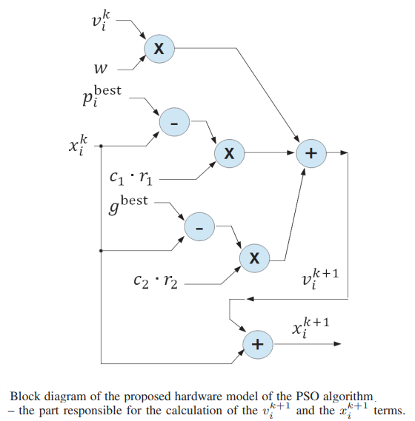

Basic parallel operations and components used in proposed hardware model of PSO Algorithm p.1
Calculation of $p^{bⅇst}$ and $g^{bⅇst}$ signals
Updating the velocities of the position of particles
Fig.4 Block diagram 1 (Research paper, 2017)
Notes:
Slide intro This series of slides will be dedicated to explanation of how major calculation operations can be implemented at the transistor level - Calculation of $p^{bⅇst}$ and $g^{bⅇst}$ signals
One of the problems encountered by the author of the proposed hardware model is the necessity of the calculation of the fitness function. In the worst case it is assumed that the shape of this function is not known in advance. In this case the $p^{bⅇst}$and $g^{bⅇst}$ values returned by this function has to be determined outside the chip on the basis of current positions of particles. Similar situation occurs when a swarm arrives in a new area, the map of which is not yet known.
- Updating the velocities of the position of particles
The calculation of the updates of the velocities (Δx factor) and the positions of particles require several basic operations, schematically shown in Fig.4. As it can be seen This block contains two summing, two subtracting and two multiplication blocks. The r, c and w signals are constants that in the proposed solution are represented by multi-bit digital signals. The r1 ·c1 and r2 ·c2 terms are kept in the memory as single constants. At the end updated values of the x and the v terms substitute their previous values stored in analogue memory block associated with each particle. The same circuit is also used to update the values of the pbest and gbest signals in the memory.

Slide 8
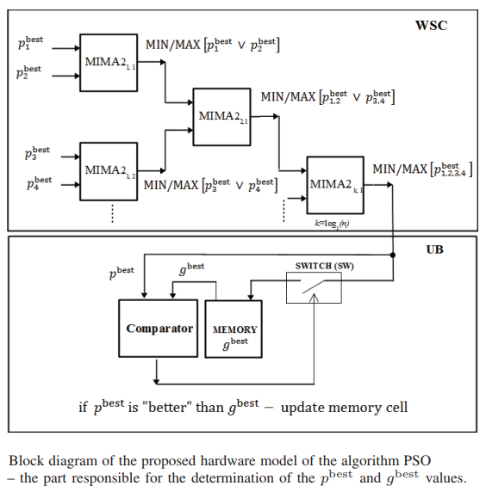
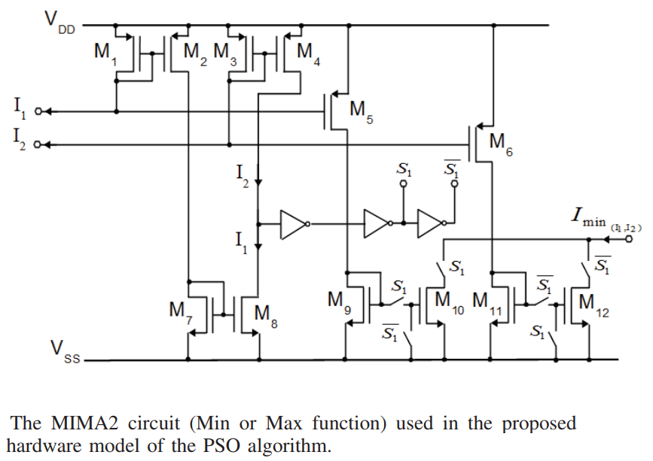
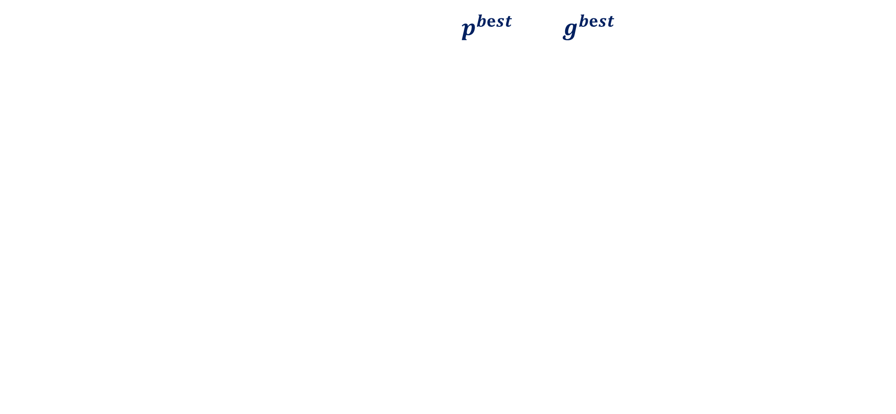
Basic parallel operations and components used in proposed hardware model of PSO Algorithm p.2
Parallel searching for best value among the $p^{bⅇst}$ and $g^{bⅇst}$ signals
Fig.5 Block diagram 2 (Research paper, 2017)
Fig.6 Block diagram 3 (Research paper, 2017)
Notes:
Parallel searching for best value among the $p^{bⅇst}$ signals
Operation of parallel searching for the best value among the $p^{bⅇst}$ signals are carried out by using a conventional Min or Max circuit (MIMA2) Search operation is performed by use of a binary three winner selection circuit. Simplified version is demonstrated by Fig5. Whole circuit is composed of MIMA2 blocks shown in FIG6. Multiple blocks allow for accelerated parallel search process to determine a single maximum or minimum value of two separate particles input. Best value is determined in steps at particular layers of the tree. At the first layer particular pbest i values directly compete in pairs. The winner from each pair is allowed to take part in the competition at the second layer.

Slide 9
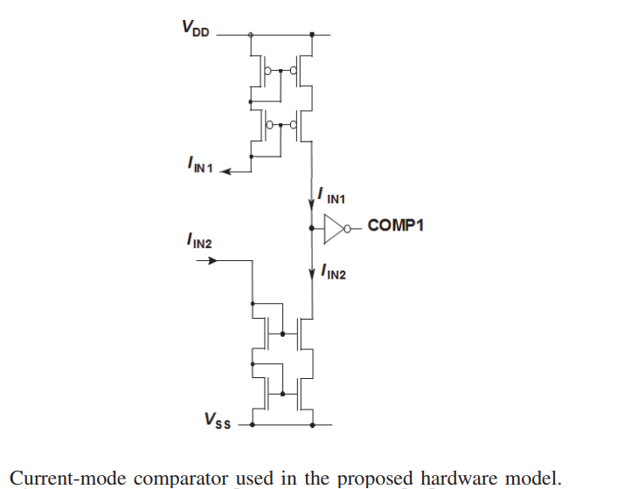
Basic parallel operations and components used in proposed hardware model of PSO Algorithm p.3
Current mode comparator
Fig.7 Block diagram 4 (Research paper, 2017)
Notes:
Current mode comparator
Finally the core block of this circuit is a current-mode comparator presented in figure 7 The main role is of current mode comparator is to compare $p^{bⅇst}$ and $g^{bⅇst}$ value. This can be observed in figure 6

Slide 10
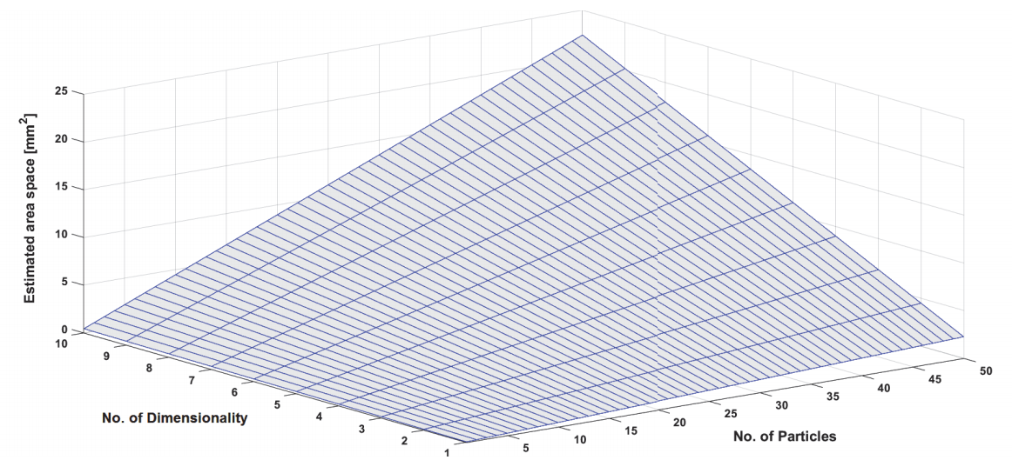
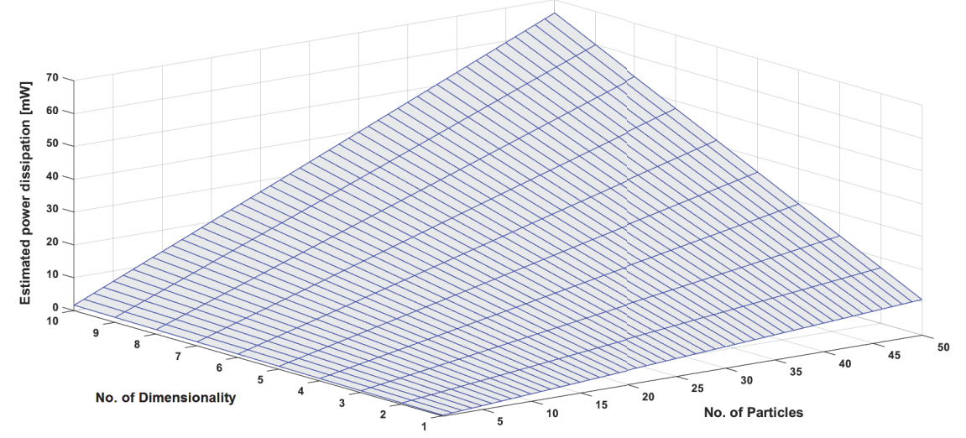
Results and performance analysis
According to the research paper (Research paper, 2017), proposed model is currently under development. However most of the components were already implemented in the transistor level. This allowed to have reliable estimates.
Fig.8 Graph 1[top] chip area
Graph 2[bottom] power dissipation (Research paper, 2017)
Notes:
Over here we can see estimates of parameters such as the hardware complexity (on the top) and the power dissipation of these components (on the bottom)

Slide 11
Conclusions
According to the report, authors attention was fully directed at custom implementation of the PSO algorithm at the transistor level. Investigations proved that designing analogue components was very challenging. According to the research materials and information provided there is a room for novelties in this area.

Slide 12
References
Wikimedia Commons (2018) Particles Animation [GIF]. In Commons Wikimedia [online] Available from: https://commons.wikimedia.org/wiki/File:ParticleSwarmArrowsAnimation.gif [Accessed 29 November 2018]
Stemmer-imaging (2018) FPGA Diagram [Photograph]. In Stemmer-Imaging[online] Available from: https://www.stemmer-imaging.com/en-gb/technical-tips/introduction-to-fpga-acceleration/ [Accessed 30 November 2018]
Research Paper(2017) Hardware Implementation of the Particle Swarm Optimization Algorithm [Online] Place of publication: Proceedings of the 24th International Conference "Mixed Design of Integrated Circuits and Systems", June 22-24, 2017, Bydgoszcz, Poland. Available from: https://ieeexplore.ieee.org/abstract/document/8005267 [29 November 2018]

Slide 13

Questions
Notes:
Image sourced from (https://www.google.co.uk/search?q=questions&rlz=1C1CHBF_enPL791PL791&source=lnms&tbm=isch&sa=X&sqi=2&ved=0ahUKEwiht6evwP3eAhWfXhUIHeiFAz4Q_AUIDigB&biw=1440&bih=758#imgrc=fJygo1neGzCf0M:)

